Slide 1

Pinpointing & Exploiting Performance Bottlenecks
Revised for:
Software Test & Performance Conference
November 2006 Boston, MA
First Presented for:
IBM Rational Users Conference, 2004
Scott Barber
Chief Technologist
PerfTestPlus, Inc.

Slide 2
Who Am I?
Chief Technologist, PerfTestPlus, Inc.
Co-Founder, Workshop On Performance & Reliability
Executive Director, Association of Software Testing
Author of over 50 academic & practitioner papers on performance testing
International Keynote Speaker and Trainer
To some, I'm an “expert” performance test consultant
Others call me the “Perf Guy”
In Short...

Slide 3
Who Am I?
My name is Scott Barber and I'm a
Test-aholic

Slide 4
Introduction
This presentation is adapted from User Experience, not Metrics: Parts 6, 8, 9 and10 and Beyond Performance Testing: Parts 6, 7, 8, 9, 10 located at www.perftestplus.com/ and various client engagements.

Slide 5
Agenda
Overview
Analyzing Results to Identify Bottlenecks
What the Development Team Needs to Know
Identify Tier of Detected Issue
Identify Component of Detect Issue
Develop Test To Exploit Issue
Available Tools
Summary

Slide 6
Overview
One part of the system is always slowest
(the bottleneck).
Until it is remedied, no other tuning will actually improve the overall performance of the application along that path.
Before that bottleneck can be tuned, it must first be conclusively identified.

Slide 7
Overview
Once a bottleneck is identified,
resolution can be reached more quickly
if your existing tests
are modified to eliminate distraction
from ancillary issues.
Pinpointing exactly where the bottleneck is
is an art all its own.

Slide 8
Overview
After determining where the bottleneck is architecturally, a new test will likely be needed to exploit it in order to help the development team with tuning.
These bottleneck exploiting tests needn’t bear any resemblance to real user activity but rather
focus on the bottleneck alone.
In fact, these tests often don’t even interact with the system in ways users could and
may include direct interaction with back-end tiers.

Slide 9
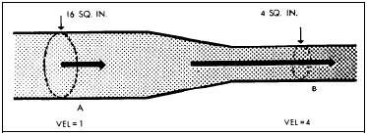
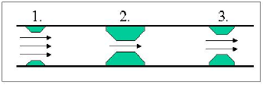
Intro – Scott’s Rules of Bottlenecks
A bottleneck is a slowdown. A stoppage is a failure.
Bottlenecks don’t exist exclusively under load.
The symptoms of the bottleneck are
(virtually) never observed at the
actual location of the bottleneck.
The critical bottleneck is the one along a particular user path that will both improve performance
and enable the ability to find other
bottlenecks once removed.
If you have multiple paths through a system and a bottleneck, you should isolate the paths and evaluate them separately.

Slide 10
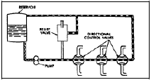
Intro – Scott’s Rules of Bottlenecks
The bottleneck is more likely
to be found in the hardware
or software than in the
network, but the network
is easier to check.
Unless other activities and/or users are affected by the observed slowness or its cause, it’s not a bottleneck but a slow spot.
When reporting bottleneck suspects, don’t assume you know the cause, just report the symptoms.

Slide 11
Analyzing Results to ID Bottlenecks
Use visual representations of data
Edward Tufte, Ph.D., Professor Emeritus of political science, computer science and statistics, and graphic design at Yale.
According to ET:
Power Corrupts...

Slide 12
Analyzing Results to ID Bottlenecks
PowerPoint Corrupts Absolutely.

Slide 13
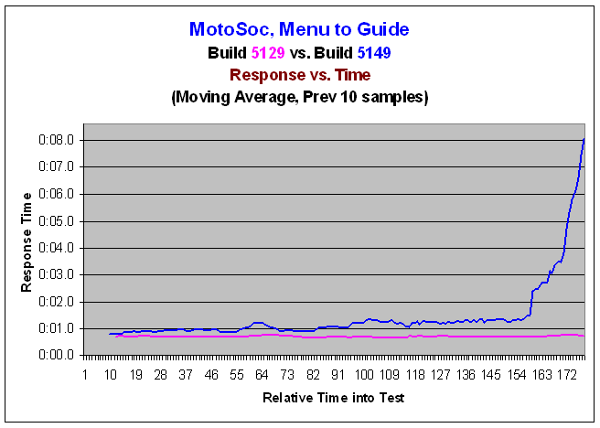
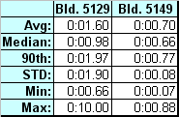
Analyzing Results to ID Bottlenecks
Examine Response vs. Time Charts/Tables

Slide 14
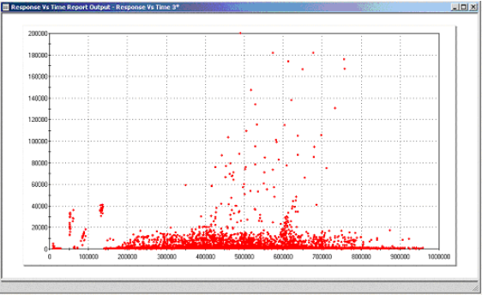
Analyzing Results to ID Bottlenecks
Study Scatter Charts

Slide 15
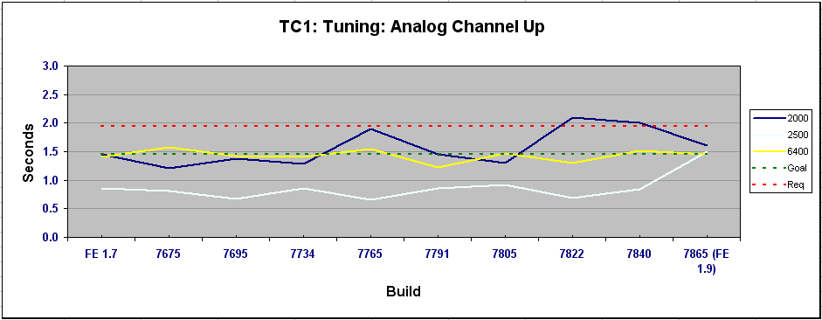
Analyzing Results to ID Bottlenecks
Evaluate Patterns and Trends

Slide 16
Analyzing Results to ID Bottlenecks
Rely on Personal Observation
Listen to Third Party Comments
Confirm Suspects
Reproduce Results
  Exactly
  Manually
  With Similar Tests
  With Minimalist Tests
  With Not-So-Similar Tests
Report Suspects
  Verbally
  Visually
  Via Demonstration

Slide 17
What the Dev Team Needs to Know
Which related activities produce the same symptoms?
Which other activities are affected by the bottleneck?
What were the load characteristics of the test yielding the symptoms?
What data did you use to create the symptoms?
What’s the configuration of the environment you’re testing?
Other metrics the developers wanted you to collect.

Slide 18
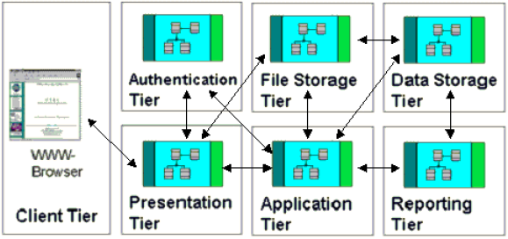
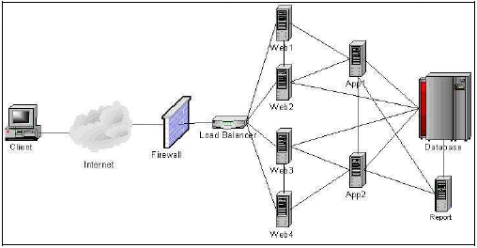
Identify Tier of Detected Issue
Logical
Architecture
Physical Architecture

Slide 19
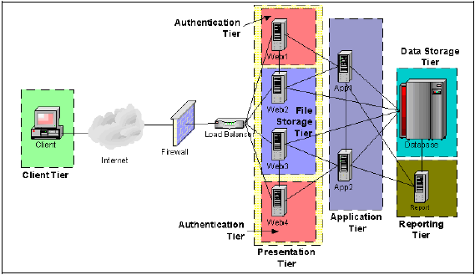
Identify Tier of Detected Issue
Physical Architecture with Logical Overlay

Slide 20
Identify Tier of Detected Issue
Design Tests to Determine Tier
  Ask “What if…? Questions.
  Ask Developers to Speculate
  Evaluate Commands with Slow Responses
  Think in Terms of Distinguishing Failures, Slow Spots and Bottlenecks
  Visualize and Prioritize
Modify Existing Tests
Create New Tests
  Use Same Tool
  Use Different Tool
  Use Test Harnesses

Slide 21
Identify Tier of Detected Issue
Speak Intelligently with the Development Team
Capture Metrics by Tier
  Resource Utilization
  Response Times
  Others Identified by Developers
Interpret Metrics
  Look for the Obvious
  Consult Development Team
  Change Tests to Prove (or Disprove) Theories

Slide 22
Identify Component of Detected Issue
Once Tier is Identified…
  Further Narrowing may be Required
  Same Principles as Identifying Tier
Speak Intelligently with the Development Team
Capture Metrics by Component
  Resource Utilization
  Response Times
  Others Identified by Developers
Interpret Metrics
  Look for the Obvious
  Consult Development Team
  Change Tests to Prove (or Disprove) Theories

Slide 23
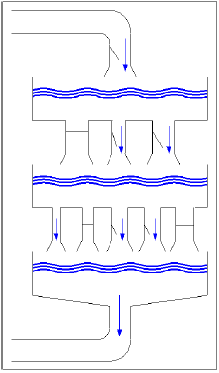
Develop Test To Exploit Issue
Lessons from Hydrodynamics
  Pools/Queues
  Flows/Threads/Processes
  Pipe Size/Throughput

Slide 24
Develop Test To Exploit Issue
Exploitation Methods
  Bounds Conditions
  Breakpoints
  Resource Constraints
Hand off to Development Team
  Following Development Team’s Lead
Different Testing Styles
  Black-Box
  Grey-Box
  White-Box
Knowing When to put the Load Generation Tool Away

Slide 25
Available Tools
Common
  LoadRunner, Silk Performer, Rational Performance Tester, OpenSTA, Visual Studio Test System, eLoad
  Purify, Quantify, Performassure
  J-Meter, Perfmon, Perfmeter, Top
  WebTrends, WebLogic, Tivoli, MOM
Other Performance Test/Monitoring Tools
  Load Generation
  Performance Monitoring
  Performance Analysis
  OS/System Specific Tools
  Application Specific Tools

Slide 26
Available Tools
Other Analysis Tools
  Spreadsheets
  Statistical Calculators
  Mathematical Graphing
  Graphical Presentation
Most Important Tools
  Your Brain
  Your Development Team

Slide 27
Want More Information?
Information adapted from User Experience, not Metrics: Parts 6, 8, 9 and10 and Beyond Performance Testing: Parts 6, 7, 8, 9, 10 located at http://www.PerfTestPlus.com
Ask me directly on the Performance and Load Testing forums
http://SQAForums.com (Huge QA Forum)
Good sources for additional information about Performance Testing:
  http://www.PerfTestPlus.com (Methodology, Templates, Articles, Presentations)
  http://www.loadtester.com (Good articles and links)
  http://www.performancetester.com (Tons of good resources)
Graphical Presentation of Information – Edward Tufte, PhD. http://www.edwardtufte.com (Books and seminars)

Slide 28
Summary
Report Symptoms, not Solutions/Reasons
Verify Observations
Analyze Results Collaboratively
Don’t Over-depend on your Initial Tests
Determine Related and Unrelated Activities
Analyze, Analyze, Analyze (Collaboratively)
Know When to Hand-off to the Development Team
Yours is a Support Role
Document Conclusions
Document Recommendations

Slide 29

Questions

Slide 30
Contact Info
Scott Barber
Chief Technology Officer
PerfTestPlus, Inc
E-mail:
sbarber@perftestplus.com
Web Site:
www.PerfTestPlus.com

